Slide 1

Vel Tech Rangarajan Dr. Sagunthala R&D Institute of Science and Technology
School of Computing
Department of Computer Science and Engineering
10211CS224 / FULL STACK APPLICATION DEVELOPMENT (JAVA)
END SEMESTER PROJECT REVIEW
Date: 06-05-2026
SMART CAMPUS EVENT MANAGEMENT SYSTEM
SDG: SDG 4 – Quality Education
Presented By:
V.Akhilesh – VTU24652 – Reg.No. 23UECS0909
Courses Handling Faculty:
Dr.Hafizur Rahman
Assistant Professor

Slide 2
INTRODUCTION
1
In many organizations and institutions, event management still depends heavily on manual coordination, phone calls, and repeated message sharing.
This often leads to missed updates, confusion in scheduling, and poor participant management.
Smart campus event management system helps all users stay updated without needing repeated manual follow-ups.
The system allows admin to create and edit events.
Students can browse a live feed of events and register with just one click.
Overall, it is a modern platform designed to improve event planning, coordination, and communication.
2
3
4
5
6
7
8
9

Slide 3
PROBLEM STATEMENT
1
Manual registration processes create high administrative workloads and lead to frequent data entry errors.
Students lack a centralized digital dashboard to track their personal registration history and schedules.
There is no real-time analytical system to help administrators monitor student engagement or event popularity.
Communicating schedule or venue changes manually is slow and often fails to reach all participants in time.
Manual data management prevents the institution from generating fast and accurate attendance reports.
Existing methods lack the automation required to ensure a reliable and streamlined event management experience.
2
3
4
5
6
7
8
9

Slide 4
OBJECTIVES
1
2
To design and develop a centralized web-based system that automates the entire campus event discovery and registration process.
To implement a real-time analytics dashboard for monitoring student participation and improving overall administrative data accuracy.
3
4
5
6
7
8
9

Slide 5
PROPOSED SYSTEM
The proposed system is a centralized web-based platform built with Spring Boot and Thymeleaf for end-to-end campus event management.
It includes a secure admin dashboard for managing event lifecycles and a dedicated student portal for registrations.
By automating the registration process, it eliminates the need for manual paperwork and reduces human errors in participant tracking.
It addresses the lack of insights by providing real-time analytics and data visualizations to monitor student engagement levels.
The platform offers superior accessibility, allowing users to register for and manage events 24/7 from any device.
Centralized data storage ensures higher security and integrity of student records compared to manual spreadsheets.
Automated confirmation and notification systems significantly enhance the speed and reliability of campus-wide communication.
1
2
3
4
5
6
7
8
9

Slide 6
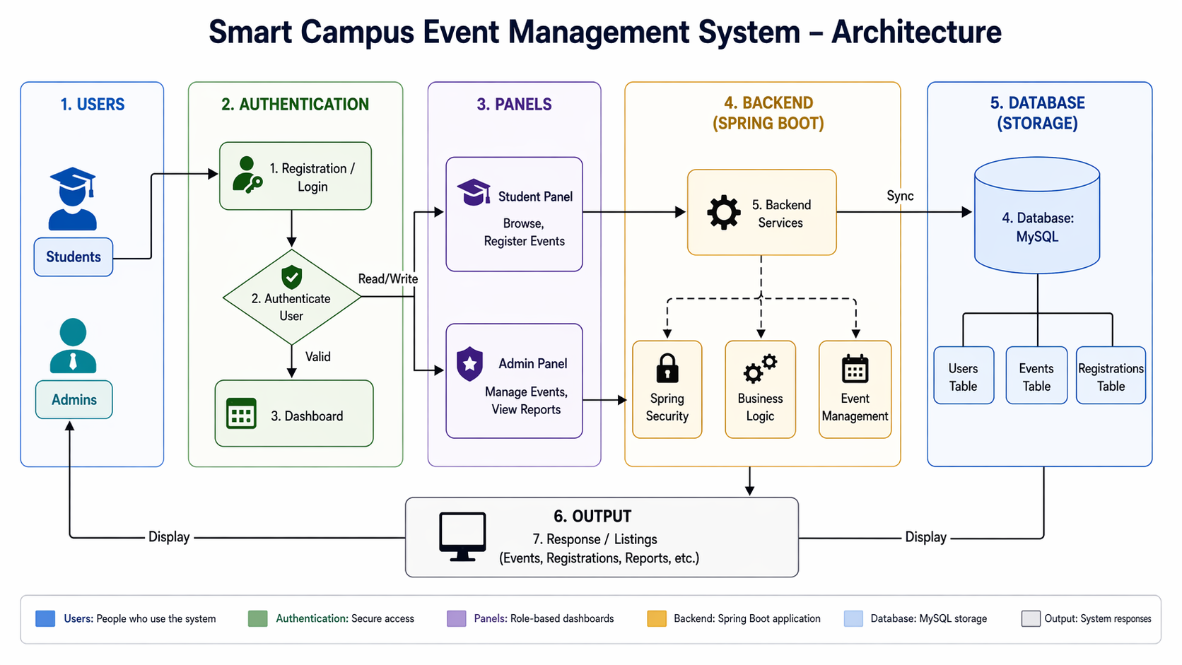
PROPOSED SYSTEM ARCHITECTURE
1
2
3
4
5
6
7
8
9

Slide 7
PROPOSED SYSTEM ARCHITECTURE
1
Input: User data such as event details, participant invitations, responses, and event updates are entered into the system.
Processing: The system processes the input by handling event creation, updating records, sending notifications, and synchronizing data in real time.
Database: All information related to users, events, participants, and status is stored securely in the database for quick access and management.
Output: The system displays updated event information, participant status, instant notifications, and synchronized results to all users.
2
3
4
5
6
7
8
9

Slide 8
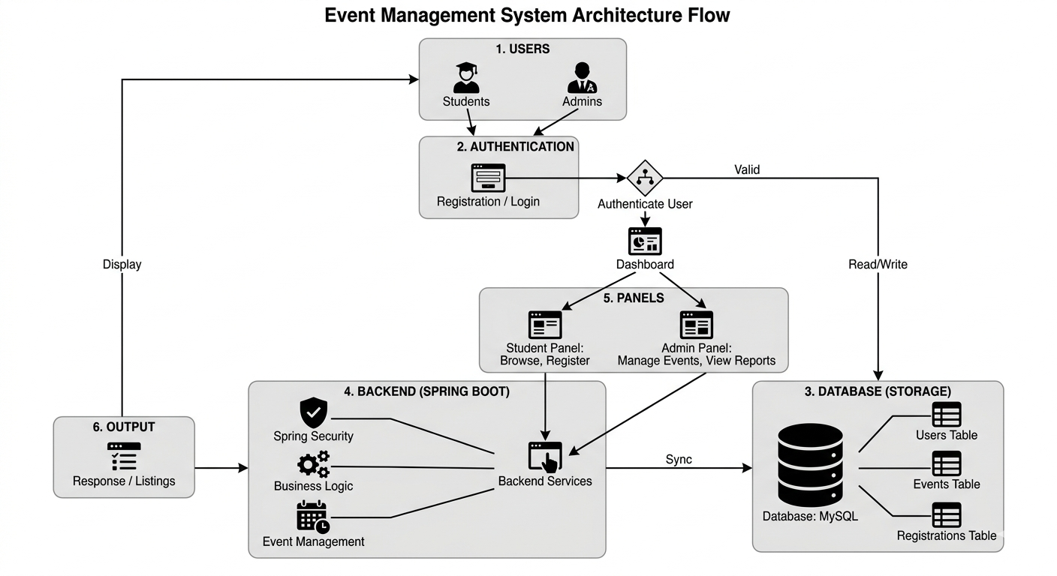
WORKFLOW
1
2
3
4
5
6
7
8
9

Slide 9
TECHNOLOGIES USED
1
Frontend: HTML5, CSS3, JavaScript
Backend: Java, Spring Boot
Database: MySQL
Tools: Visual Studio Code, Git, GitHub, Postman, Maven
Hardware/Software Requirements: Computer with minimum 4 GB RAM, dual-core processor, Node.js environment, modern web browser, and operating system such as Windows, Linux, or macOS
2
3
4
5
6
7
8
9

Slide 10
MODULE DESCRIPTION
Module 1: User Authentication and Management
Handles student registration, login, secure authentication, and basic profile-related information for accessing the system.
Module 2: Event Management
Admins can create new events, specifying date, time, venue, and descriptions..
Module 3: Administrative Control Hub
Provides administrators with tools to create, edit, or delete events and manage the comprehensive list of participant registrations.
Module 4: Analytics & Visual Reporting
Utilizes Chart.js to generate real-time visual insights into event popularity, registration trends, and student participation metrics.
1
2
3
4
5
6
7
8
9

Slide 11
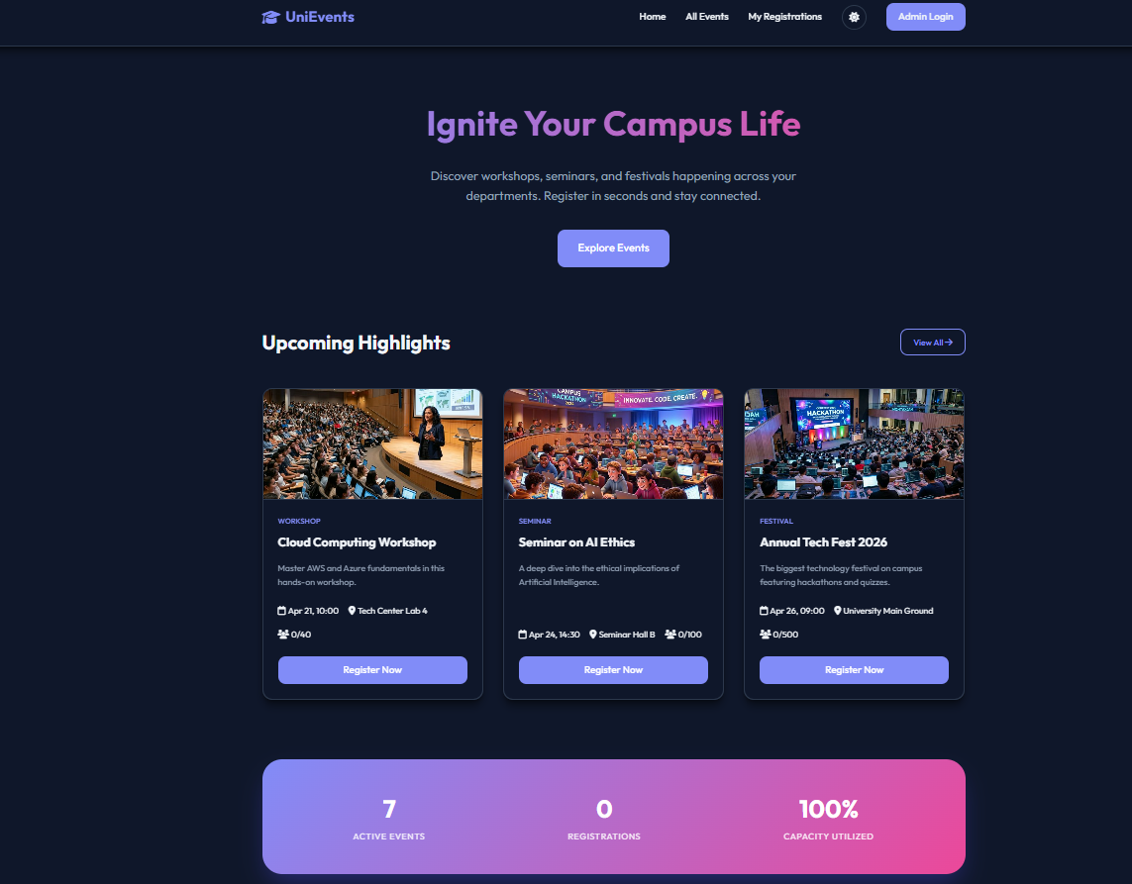
IMPLEMENTATION SCREENSHOTS
1
2
3
4
5
6
7
8
9
Image 1: Dashboard of the website with details regarding events

Slide 12
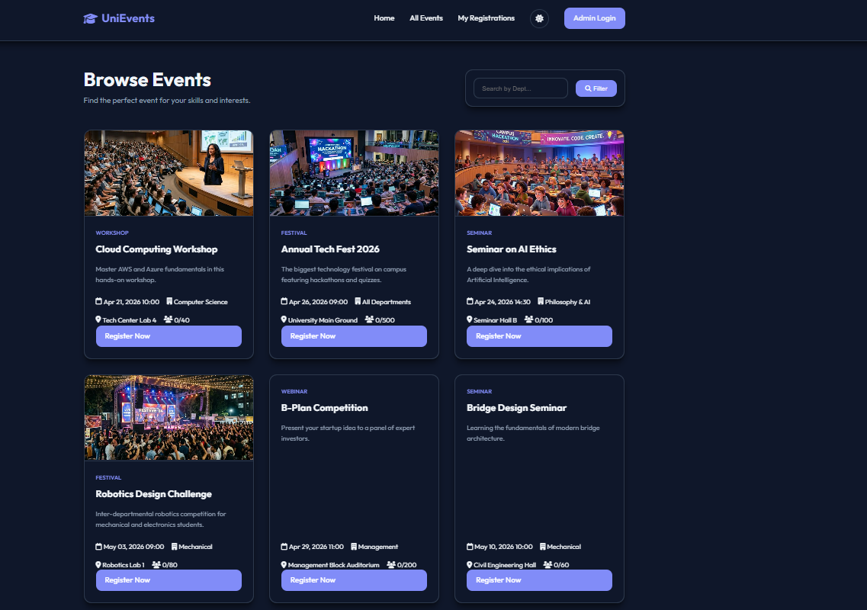
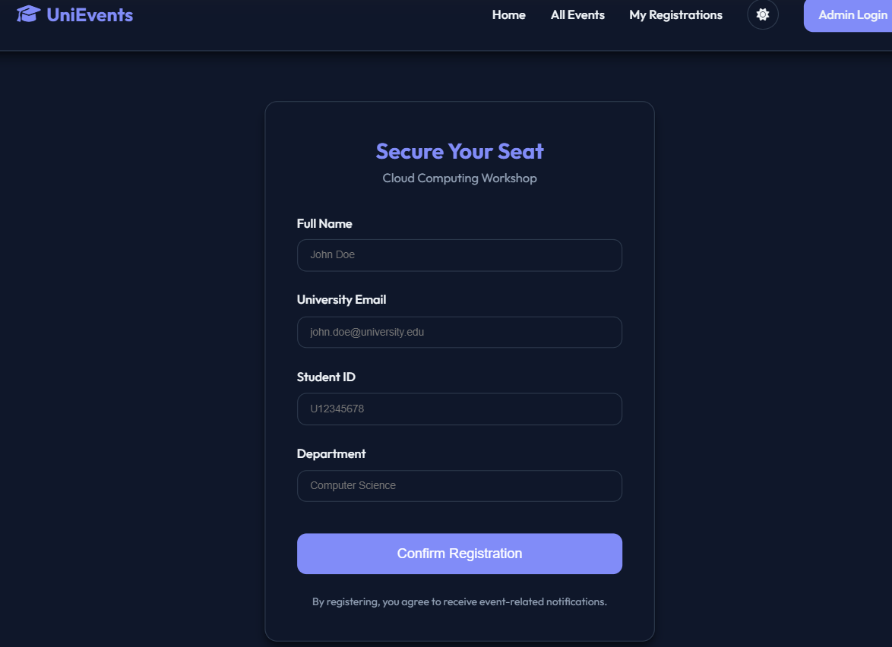
IMPLEMENTATION SCREENSHOTS
1
2
3
4
5
6
7
8(A)
9
Image 2: Events screen of the student with details regarding available events.
Image 3: Registration screen of student where they can enter credentials.

Slide 13
ADVANTAGES & LIMITATIONS
1
Advantages:
Centralization: All campus activities in one unified digital platform.
Automation: Eliminates manual paperwork and administrative errors.
Data Insights: Real-time visual tracking of student engagement.
Accessibility: 24/7 mobile-friendly registration for all students.
Limitations:
Connectivity: Requires a stable internet connection to function.
User Adoption: Effectiveness depends on institutional-wide usage.
Maintenance: Needs regular updates for data security and privacy.
Initial Input: Requires time-consuming initial setup for event data.
2
3
4
5
6
7
8
9

Slide 14
Thank you

